Slide 1
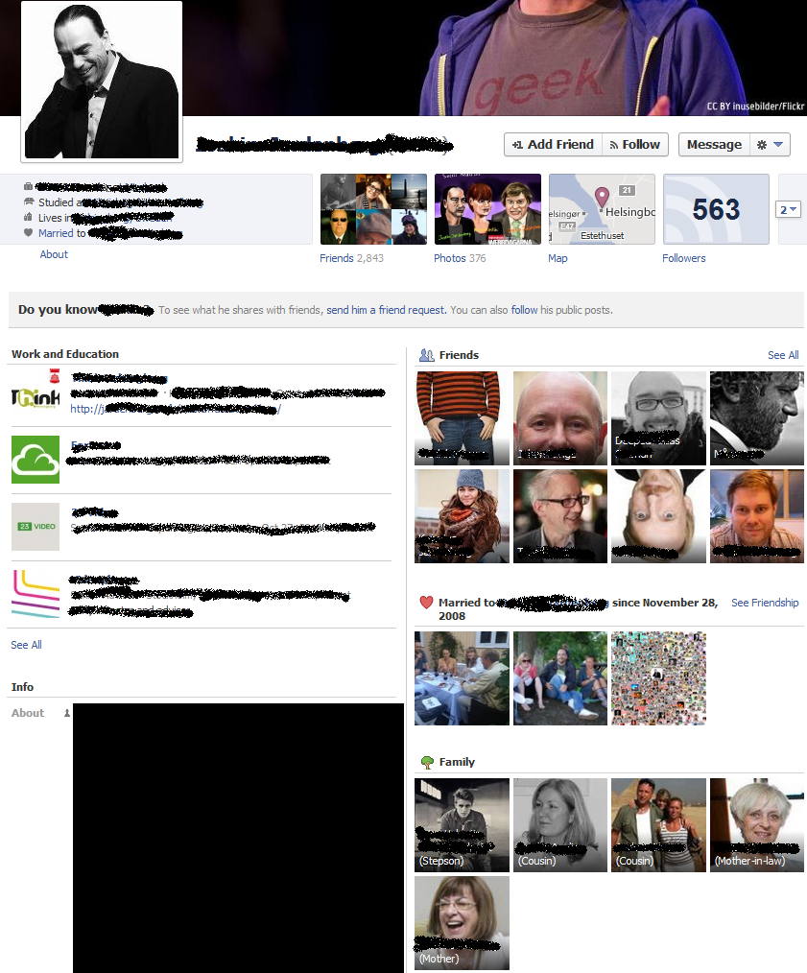
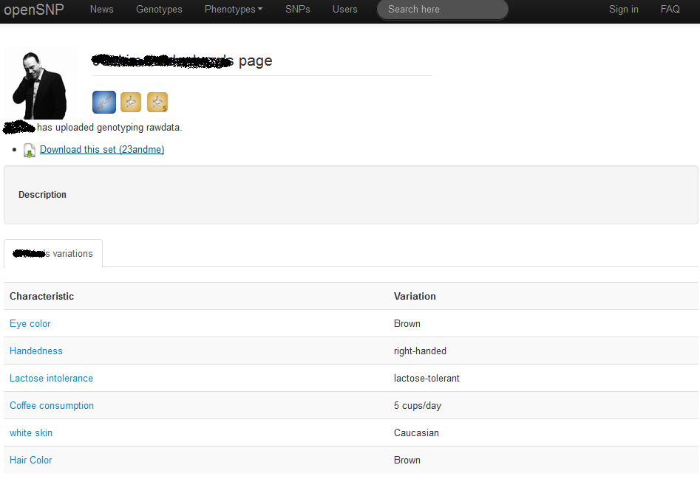
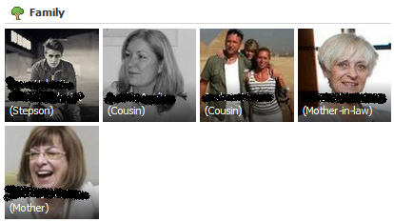
Kin Genomic Privacy
Correlated genetic information between family members => an individual sharing his/her genome threatens his (known) relatives’ genomic privacy
Notes:
After having been sequenced, the person can freely put his genome available online through websites like OpenSNP.org, like the person here. […] this means that, not only the Lacks family’s genomic privacy is at risk but thousands of family’s privacy is now in danger.
Possible to gather family relationships (pedigrees) with real identities from social networks (such as Facebook) or genetic genealogy Websites (such as 23andMe)
People whose genome has been sequenced increasingly share it online, sometimes with their real identities (like in OpenSNP)
Following this trend, genomic Websites might merge with social networks in a near future (health social networks like PatientsLikeMe are good examples)
Due to the inherent genetic correlation of relatives, every individual who reveals his genome (or part of it) can eventually put his relatives’ genomic privacy at risk

Slide 2






Quantifying Kin Genomic Privacy
Target Pedigree
9
10
1
2
Target Person
3
4
5
6
7
8
M. Humbert, E. Ayday, J.-P. Hubaux, and A. Telenti. Addressing the concerns of the Lacks family: Quantication of kin genomic privacy. CCS, 2013.

Slide 3
Surname Inference Attack
Goals:
Recover the surname of sequence donors from 1000 Genome Project
Triangulate the identity of a sequence donor using his surname, age and state
Using:
Surnames are paternally inherited in most human societies
Y-chromosome haplotypes in male individuals are directly inherited from the father
M. Gymrek, A. L. McGuire, D. Golan, E. Halperin, and Y. Erlich. Identifying personal genomes by surname inference. Science: 339 (6117), January 2013.

Slide 4
Surname Inference Attack
Surname inference
Profile short tandem repeats (STR) on the Y-chromosome
A small repeating sequence in DNA.
Query recreational genetic genealogy databases
Obtain a list of possible surnames for the sequence in question
Identity Triangulation
Combine surnames with age and state
Triangulate the identity of the target (using US censuc database)
Vinicius Vielmo Cogo: An example of DNA re-identification attack

Slide 5
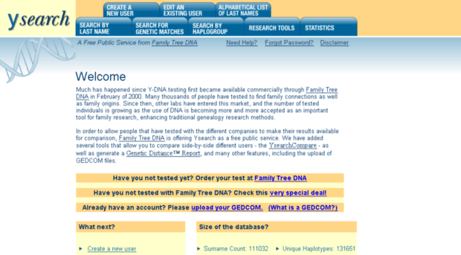
Surname Inference Attack

Slide 6
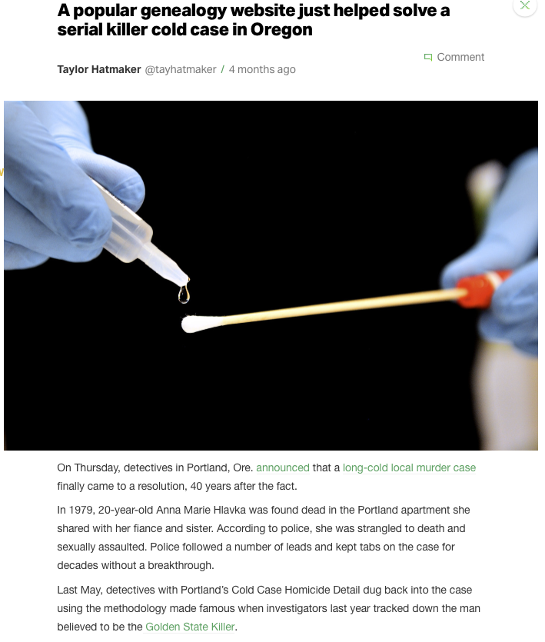
TechCrunch
January 31, 2019

Slide 7
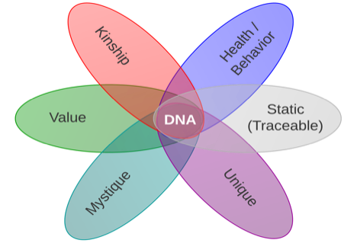
What If Genomic Data Are Leaked?
Genomic data pose special privacy problems:
They are inherently identifying
They can’t be changed (as opposed to passwords)
They have unique statistical regularities
They contain sensitive and personal information (genetic diseases or propensity to develop certain conditions)
Their leakage can expose individuals to genetic discrimination
Relatives can also be affected
[Naveed et al.’15]

Slide 8

Genome Privacy and Security: a Grand Challenge for Mankind
Required duration of protection >> 1 century
(Current) data size: around 300 GBytes / person
Need sometimes to carry out computations on millions (if not more) of patient records
Noisy data
Correlations
within a single genome (“linkage disequilibrium”)
across genomes (kinship, ethnicity)
Several “semi-trusted” stakeholders: sequencing facilities (including Direct-to-Consumer companies), hospitals, genetic analysis labs, private doctors,…
Diversity of applications (and thus of requirements): healthcare, medical research, forensics, ancestry

Slide 9
Canonical Misconception about Genome Privacy and Security
Genome privacy is hopeless, because all of us leave biological cells (hair, skin, droplets of saliva,…) wherever we go
Those cells can be collected and used for DNA sequencing
Hence trying to secure genomes is a lost battle
What is wrong with this reasoning?
Collecting human biological samples and sequencing them is expensive, illegal, prone to mistakes, and non-scalable! (even if sequencing techniques keep improving)
The medical community (research and healthcare) should not be the (indirect) accomplice of massive leaks of sensitive data

Slide 10
Security / Privacy Requirements for Personalized Health
Pragmatic approach, gradual introduction of new protection tools
Different sensitivity levels of the data
Different access rights
Exploit existing data (electronic health records) and tools
Be future-proof (no short-sighted “bricolage”)
Awareness and enforcement of patient consent

Slide 11
Technologies for Privacy and Security Protection
Traditional Encryption
Homomorphic Encryption
Secure Multiparty Computation
Protects data at rest and in transit
Cannot protect computation
Protects computation in untrusted environments
Limited versatility vs efficiency
Protects computation in distributed environments
High communication overhead
Trusted Execution Environments
Differential Privacy
Distributed Ledger Technologies (Blockchains)
Protects computation with Hardware Trusted Element
Requires trust in the manufacturer, vulnerable to side-channels
Protects released data from inferences
Degrades data utility (privacy-utility tradeoff)
Strong accountability and traceability in distributed environments
Usually no data privacy

Slide 12

Deterministic vs probabilistic encryption
Deterministic encryption
Preserves and leaks equality of the the plaintext
More general property-preserving schemes can focus on other properties (e.g., order, format,…)
Plaintext
Cyphertext
Age
5
5
5
5
5
5
10
10
10
10
Age
TRxZDzVYjV
TRxZDzVYjV
TRxZDzVYjV
TRxZDzVYjV
TRxZDzVYjV
TRxZDzVYjV
kt6gUXGWgL
kt6gUXGWgL
kt6gUXGWgL
kt6gUXGWgL
A value occurs six times
Deterministic Encryption
Another value occurs four times

Slide 13

Deterministic vs probabilistic encryption
Probabilistic encryption
Random salt added to each encryption to achieve semantic security (plaintext properties are not disclosed, and equality of plaintexts cannot be determined with non-negligible advantage)
Problem: ciphertexts cannot be compared
Plaintext
Ciphertext
Age
5
5
5
5
5
5
10
10
10
10
Age
LKGM8EUnGd
kt6gUXGWgL
TRxZDzVYjV
IgDwwF64cl
ht5UIk8Evw
kbfRQ2nRAy
R8cBg6KRrw
en0yWX5iWA
mcq3uYOAQA
EE3sF0XfTn
Probabilistic Encryption

Slide 14
Multi-site Studies – Where to Store the Data?
a. Keep them at each site
Useful especially if the cloud is untrusted
Better control of the data
b. In the cloud
Take advantage of the well-known strengths of the cloud (see next slide)

Slide 15
Multiple tenants (different, usually unrelated legal entities) store their data on an infrastructure managed by another legal entity
Benefits
Mutualization of storage and computation capabilities, but also of IT manpower
No upfront investment for the customer
Usually professionally managed, thus more secure
Privacy question: is the cloud trustworthy? → encryption solutions
Legal:
US/EU: Safe Harbor → Data Shield
US CLOUD Act (2018)
Main global providers: Amazon (AWS), Google Cloud, Microsoft Azure

Slide 17
Case 1: The Cloud is Fully Trusted – Storage in Clear Text (never happens in practice)
Data in cleartext
Data sharing is easy
Computation in the cloud is easy
Secured pipe (that’s easy)
👩‍💻

Slide 18
Case 1’: The Cloud is Fully Trusted – It encrypts with keys it controls
Encrypted
Data
Data sharing is easy
Computation in the cloud is easy
Secured pipe (that’s easy)
👩‍💻

Slide 19
Case 2: The Cloud Is Untrusted – The user encrypts under their own keys
Encrypted
Data
Data sharing is tricky (key management)
Computation in the cloud is impossible
Some of the benefits of cloud computing are thus lost
If the user loses their keys, they lose all their data
Secured pipe (that’s easy)
👩‍💻

Slide 20
Homomorphic Encryption
$$a, b$$
$$a∘b$$
compute ($∘$)
encrypt
encrypt
$$E(a), E(b)$$
$$E\left(a\right)⋇E\left(b\right)=E\left(a∘b\right)$$
Compute ($⋇$)
Homomorphic encryption enables computations directly on encrypted data.

Slide 21
Homomorphic encryption
Homomorphic Encryption and Fully Homomorphic Encryption
(Practical/Somewhat) Homomorphic Encryption $≠$ Fully Homomorphic Encryption
Somewhat Homomorphic Encryption | Fully Homomorphic Encryption (FHE)
Can perform polynomial operations of limited degree | Can perform any operation represented as a binary circuit
Need to set-up security parameters tailored for the specific computation | Generic security parameters
Arithmetic circuits and integer inputs | Logical circuits and binary inputs
Constrained computational overhead (several orders of magnitude speed-up w.r.t. FHE) | Very high computational overhead
Expansion controlled by the ciphertext/plaintext cardinality ratio | Very high expansion

Slide 22
Case 3: The Cloud is Untrusted – The user homomorphically encrypts with keys it controls (1/3)
Data sharing is doable
Computation in the cloud is possible, but expensive
Secured pipe
Encr(3)
Encr(5)
👩‍💻

Slide 23
Case 3: The Cloud is Untrusted – The user homomorphically encrypts with keys it controls (2/3)
Encr(3)
Encr(5)
Data sharing is doable
Computation in the cloud is possible, but expensive
Secured pipe
Encr(3)
Encr(5)
👩‍💻

Slide 24
Case 3: The Cloud is Untrusted – The user homomorphically encrypts with keys it controls (3/3)
Encr(3)
Encr(3+5) = Encr (8)
Encr(5)
The cloud can make computations on encrypted data, for which it does not know the crypto keys
Hence computation in the cloud is possible (albeit expensive)
Data sharing is doable
Secured pipe
Encr(3)
Encr(5)
👩‍💻

Slide 25
Multi-site Studies: Keeping the Data at Each Site Assume Sites do not trust each other → Possible solution: Secure Multi-Party Computation

Slide 26

Secure Multiparty Computation
Problem statement:
A set of players $𝒫=\{P_{1}, P_{2},…, P_{N}\}$ would like to compute a function $f\left(x_{1}, x_{2}, …, x_{N}\right)=(y_{1}, y_{2}, …, y_{N})$ of their joint inputs.
Requirements:
Privacy
No party should learn anything more than its prescribed output
Correctness
Each party is guaranteed that the output that it receives is correct
$$x_{2}$$
$$y_{2}$$
Realization:
A multiparty cryptographic protocol
$$x_{1}$$
$$x_{3}$$
$$y_{1}$$
$$f$$
$$y_{3}$$
$$x_{5}$$
$$y_{5}$$
$$x_{4}$$
$$y_{4}$$

Slide 27
Current approaches for medical data sharing
Centralized approach
Decentralized approach
e.g., Genomics England, All of Us Research Program, Human Longevity, 23andMe
e.g., GA4GH Beacon, SHRINE, PCORNet
Single point of failure
Legal, ethical and social constraints for outsourcing sensitive data
High costs (human and technical)
Low scalability (unsustainable on the long run)

Slide 28

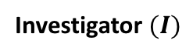
System and threat models
Clinical Site
Governmental SPU
Honest-but-curious adversary:
honestly follows the protocol
tries to infer sensitive data from the different steps of the protocol
Query
# of Patients
Clinical Site
Investigator $(I)$
Clinical Site with local SPU
Malicious-but-covert adversary:
can tamper with the protocol
tries to infer sensitive data from the query end-result
Cloud-based SPU
Clinical Site
SPU: Storage and Processing Unit

Slide 29
Designing Secure Protocols
Crucial step missing in the previous protocol design: “definition of secure”
Components of any security definition:
Network Model
Adversarial Model
Expected Security Guarantees
Without these components, it is impossible to reason about the security of a protocol

Slide 30
Network Model
Abstraction for the network
Message delivery
- Synchronous: strict upper bound on the message propagation delay
- Asynchronous: no such upper bound
Channel security
- Secret and authenticated and party-to-party channels
- Open channels
Topology
Fully vs partially connected
Access to “helper functionalities”
Authentication infrastructure
Common reference string (CRS): access to a common source of randomness
Broadcast channel
It is common to assume a convenient setting first and gradually reduce assumptions

Slide 31
Adversarial Model
Adversary can be categorized based on multiple aspects:
Set of corrupted parties
Typically a threshold $t$ on the number of corrupted parties
Honest majority vs. no honest majority
Allowed adversarial behavior
Passive: adversary that follows the protocol specification, only tries to infer information
Active: adversary that deviates arbitrarily from the protocol
Covert: adversary that can deviate from the protocol only if detection probability is low
Complexity
Probabilistic Polynomial-time: computational model for secure computation
Quantum adversary: has access to a quantum computer
Computationally unbounded: information-theoretic model for secure computation
Corruption strategy:
Static corruption: no change in the set of corrupted parties
Adaptive corruption: adversary capable of corrupting parties during the computation
Proactive defense: parties are corrupted only for a certain period of time

Slide 32
Security Guarantees
Typical set of requirements that should hold for a secure protocol:
Privacy
No party should learn anything more than its prescribed output
Correctness
Each party is guaranteed that the output that it receives is correct
Independence of Inputs
Corrupted parties must choose their inputs independently of the honest parties’ inputs
Guaranteed Output Delivery
Corrupted parties should not be able to prevent honest parties from receiving their output
Fairness
Corrupted parties should receive their outputs if and only if the honest parties also receive their outputs
However:
How can we be sure it’s exhaustive ?
They are subject to interpretation on a per-application basis
What is meant by “learning more than its own output” ? Ex. SecureSum with 2 players
What is a correct result ? Ex. Player lying on its inputs
We need a better way of formulating guarantees

Slide 33

Ideal World vs. Real World
We need a better security definition
Real world
No trusted third party exists
Real protocol
Players freely interact together
Ideal world
There exists an external party $P_{ideal}$ that:
Is trusted by all players
Is Incorruptible
Can carry out the computation
Ideal execution
Players send their inputs to $P_{ideal}$
$P_{ideal}$ computes the outputs according to $f$
$P_{ideal}$ sends each party its respective output
$$x_{3}$$
$$y_{3}$$
😇
$$f\left(x_{1}, x_{2}, x_{3}\right)=(y_{1}, y_{2},y_{3})$$
$$y_{2}$$
$$y_{1}$$
$$x_{2}$$
$$x_{1}$$
Definition of security: a real protocol is said to be secure if it emulates the ideal execution

Slide 34
Generalized Security Definition
Definition of security: a real protocol is said to be secure if it emulates the ideal execution
Alternative formulation: A real protocol is said to be secure if no adversary can do more harm in a real execution than in an ideal execution by a trusted third party
Implies all previous 5 security requirements in a general way while avoiding formulating them in an ambiguous way.
Ex 1: Privacy Requirement for SecureSum with 2 player: even an ideal execution cannot protect inputs
Ex 2: Correctness Requirement: even an ideal execution cannot prevent parties from lying
Also provides a nice way of abstracting an MPC protocol to its functionality
😇

Slide 35
Example: How much do 5 people collectively earn ?
Problem statement:
Players want to compute the sum of their salaries without revealing them
Realization:
A first (bogus) attempt:
Assume $∑x_{i}<m$
Consider inputs and +, - operation in $ℤ_{m}$
The SecureSum protocol:
$$x_{2}$$
$$m_{1}=x_{1}+r$$
$$m_{2}=m_{1}+x_{2}$$
$$r\underset{←}{Unif.}ℤ_{m}$$
$$x_{1}$$
$$∑x_{i}=m_{5}−r$$
$$x_{3}$$
$$m_{5}=m_{4}+x_{5}$$
$$m_{3}=m_{2}+x_{3}$$
$$x_{5}$$
$$m_{4}=m_{3}+x_{4}$$
$$x_{4}$$

Slide 36
Example: How much do 5 people collectively earn ?
Requirements
Privacy
No party should learn anything more than its prescribed output
Correctness
Each party is guaranteed that the output that it receives is correct
Security Concerns
What if two players collude?
Privacy requirement can break
What can the attacker do after breaking privacy?
Change its own input
Choose not to participate
???
→ It’s hard predict what the adversary will do !
Fix the protocol ?
We have found one security flaw, how many other remain ?
Iterative approach to security: Find flaw, fix flaw, repeat
→ software engineer do that, not cryptographers
Even if the protocol is correct: are the requirements exhaustive ?
$$x_{2}$$
$$m_{1}=x_{1}+r$$
$$m_{2}=m_{1}+x_{2}$$
$$r→ℤ_{m}$$
$$x_{1}$$
$$x_{3}$$
$$x_{2}=m_{2}−m_{1}$$
$$x_{5}$$
$$x_{4}$$

Slide 37
More on Secure Multi-Party Computation (SMC)
There exist operational tools, including SMC compilers
Computational overhead can be an issue
SMC can be implemented with homomorphic encryption
Some companies active in this field:
Cybernetica (ShareMind product)
Dyadic (key management)
inpher (XOR for SMC and TFHE for homomorphic encryption)
Microsoft Research
Nebula Genomics

Slide 38
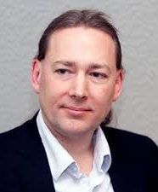

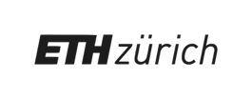
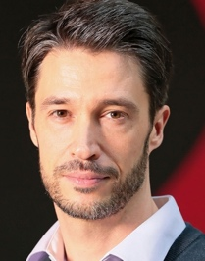
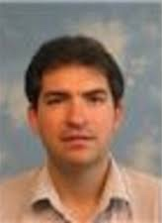


DPPH – Data Protection in Personalized Health
https://dpph.ch
LCA1: Systems for privacy-conscious data sharing
GR-JET: Fundamental cryptography
Fellay Group: Medical application
SDSC: Data Science Infrastructure and Deployment
Health Ethics and Policy: Legal and Ethical analysis
DEDIS: Distributed and Decentralized Trust
5 research groups across the ETH domain + SDSC (Swiss Data Science Center)
Funding: 3 Millions CHFrs
Duration: 3 years (4/2018 - 3/2021)
Funding Program: ETH PHRT (Personalized Health and Related Technologies)
JP Hubaux
B. Ford
E. Vayena
O. Verscheure
Project goals:
Address the main privacy, security, scalability, and ethical challenges of data sharing for enabling effective P4 medicine
Define an optimal balance between usability, scalability and data protection
Deploy an appropriate set of computing tools
J. Fellay

Slide 39
Envisioned Nation-Wide Deployment
Q2: What is the survival rate for
cancer patients undergoing a given chemotherapy?
Year 2 & 3: tiered deployment, extra functionality
Q1: How many patients with BRCA1 and breast cancer?
Year 1: small-scale prototype, simple queries

Slide 40
Step 1: Secure and Decentralized Cohort Exploration

